Slide 1





28 September 2022
Stock Price TSLA Prediction
Data Digger - Digital Skola
Final Project Presentation

Slide 2


Wanta Zulfikri
Rifky Zulkarnaen Ashari
Sigit Bagus Darmawan
Septiana Tassha Nurrizqi
The Team

Slide 3
The Contents
1
4
Business Understanding
Modelling
2
Data Understanding
5
Prediction
3
Data Preparation
6
Conclusion

Slide 4



Last year, Indonesia’s foreign and domestic direct investment realisation reached Rp 901 trillion (US$ 62 billion), surpassing the official annual target of Rp 900 trillion. This is good news for the country, which is struggling to create employment opportunities and to bring its economic growth back to its pre-pandemic level. In 2022, the government has set a more ambitious investment target of Rp 1,200 trillion (US$ 83.8 billion).
Business Understanding
Investment? Why not???
Not long ago, investment was an intimidating prospect for regular Indonesians. The specialized knowledge and the lack of resources to develop it combined with horror stories of investors losing everything in a matter of minutes deterred many would-be dabblers.
So, how can we offer a solution stock price prediction using fbprophet? ☺

Slide 5


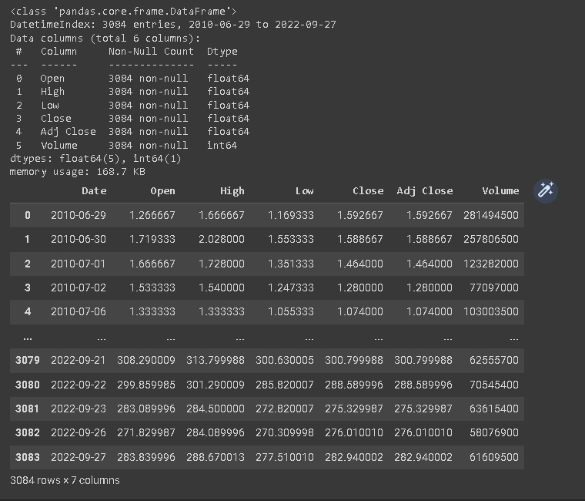

Data Understanding
Dataset served 6 columns and 3.084 rows provided.
The data types are datetime, float64, and int
The date - "Date“
The opening price of the stock - "Open“
The highest price of that day - "High“
The lowest price of that day - "Low“
The closed price of that day - "Close“
The amount of stocks traded during that day - "Volume“
The stock's closing price that has been amended to include any distributions/corporate actions that occurs before next days open - "Adjusted Close"

Slide 6

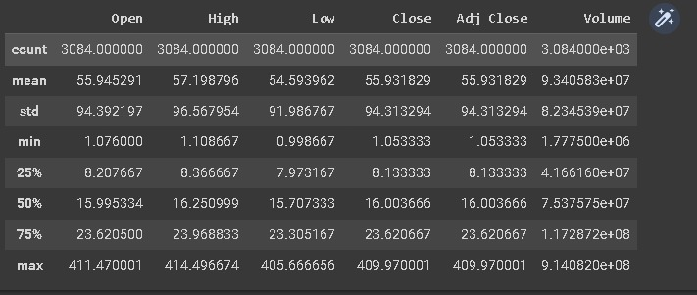
Data Understanding
Command describe helps us to explain each columns

Slide 7
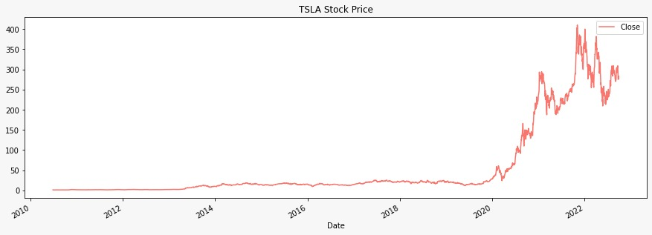
Data Preparation
Stock Price Visualization 2010 – 2022 from Dataset

Slide 8
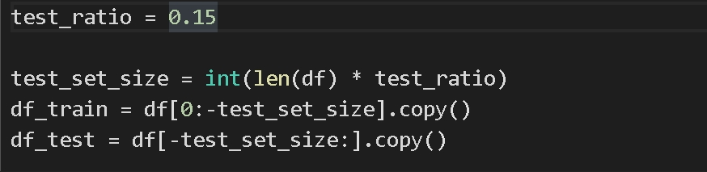
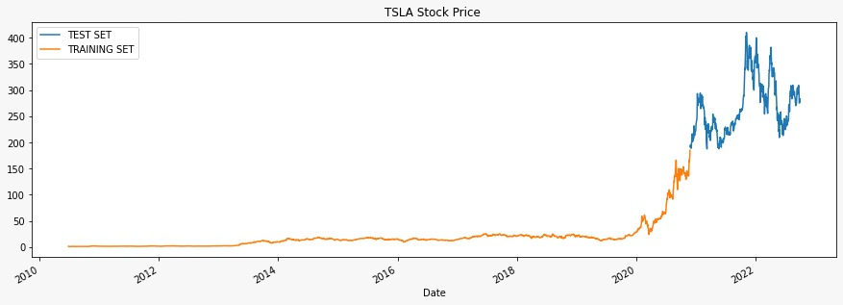
Data Preparation
85% for training and the left for testing

Slide 9
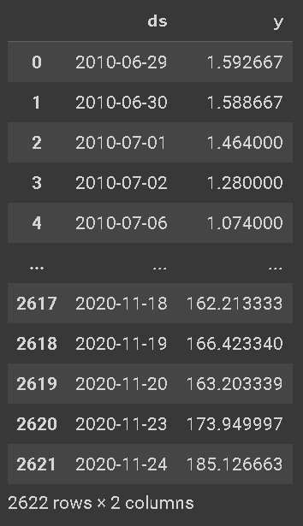
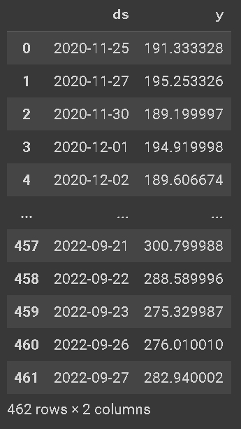
Data Training
Data Testing

Slide 10
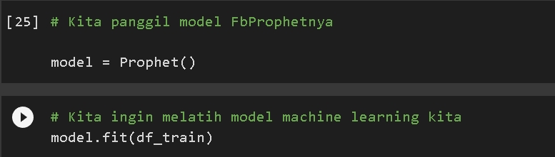
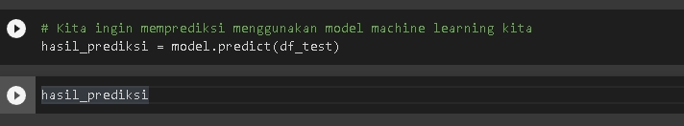
Modelling

Slide 11
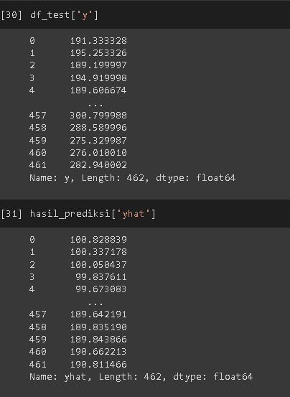
Modelling
Testing result
Prediction result

Slide 12
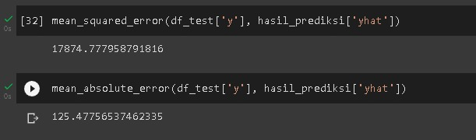
Modeling
MSE
MAE

Slide 13
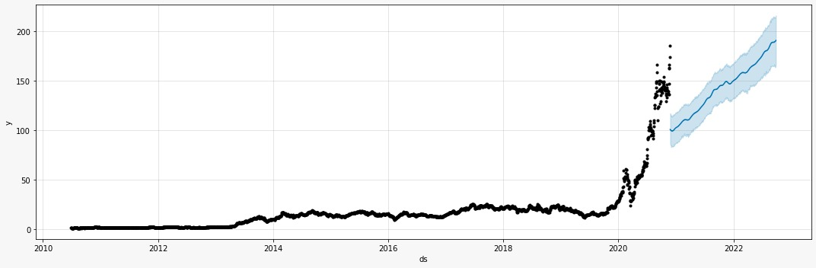
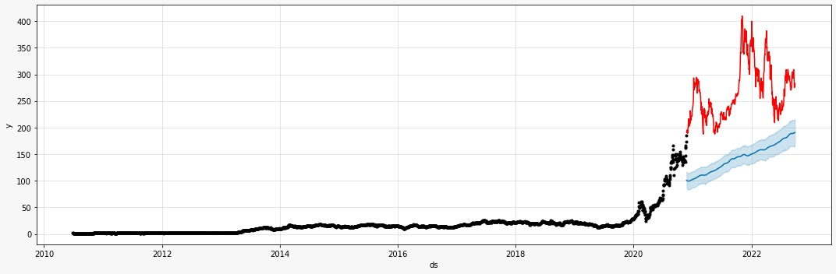
Modelling
Prediction Data Visualization

Slide 14
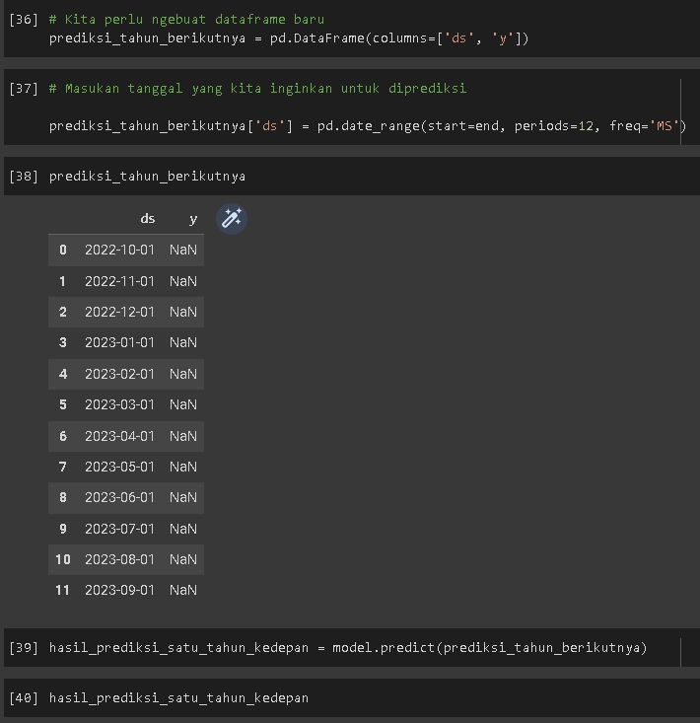
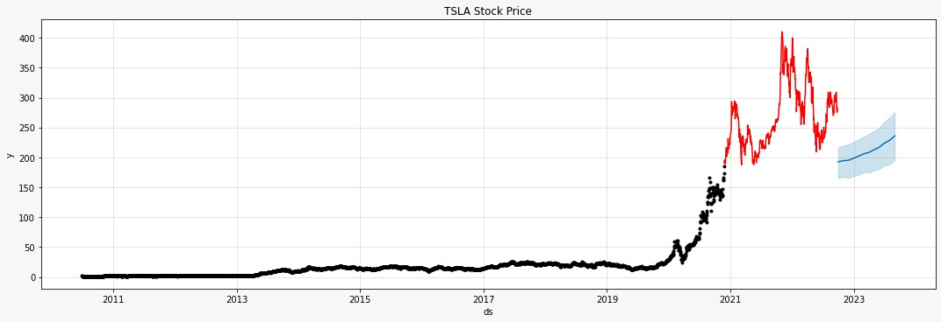
Prediction
We predict stock price in one year ahead
Data Prediction in the future

Slide 15
Conclusion
Machine learning doesn’t accurate enough to predict stock price but good in predicting the trend, because real data has not always been 100% accurate.

Slide 16
Thank you!
Hope you enjoy learning!

